Slide 1

Participant management database
Tal Ness, Tal Tehan,
Rani Gera, Noa Lezmy
Sagol School of Neuroscience,
Data Science Hackathon,
June 2018
https://github.com/NessTal/lab_database

Slide 2
Project Goal
Create an application that manages experiment participants’ data.
This management includes:
Entering new participant information
Editing existing information
Searching participants by different values
Automatizing certain functions

Slide 3
Project Demo

Slide 4
Major Components
Component 1: Database – Rani Gera – The database handles all functions relating to the creation of the data, editing existing data, extracting the data.
Component 2: GUI – Tal Ness & Tal Tehan – The GUI allows the user to view and edit the database in a convenient way, without programing knowledge.
Component 3: Email server – Noa Lezmy – The email server enables automatization of routine emails sent to participants.

Slide 5
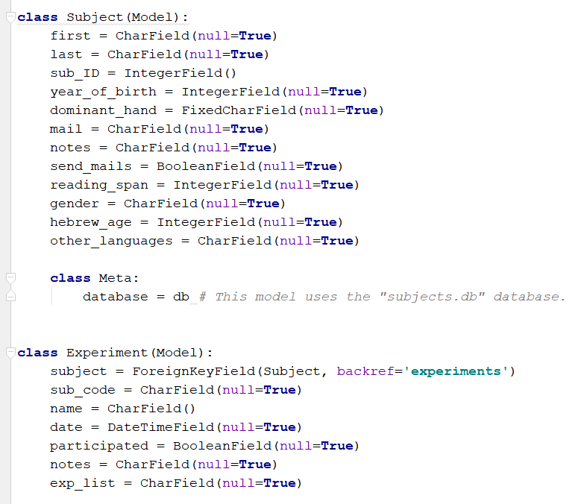
Database Features and Examples

Slide 6
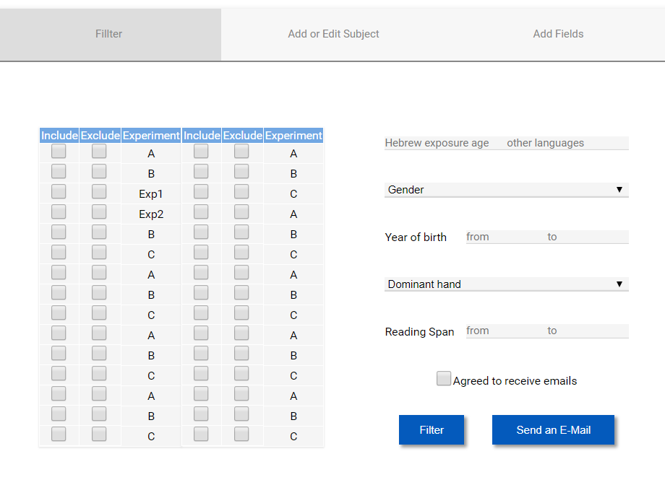
GUI Key Features

Slide 7
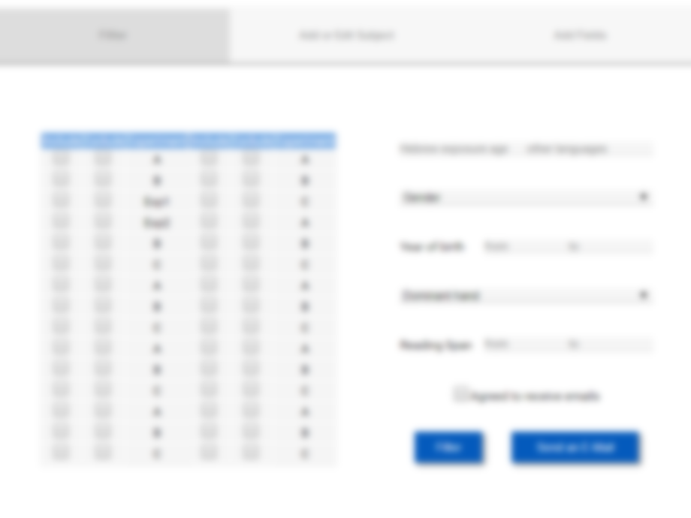
GUI Key Features

Slide 8
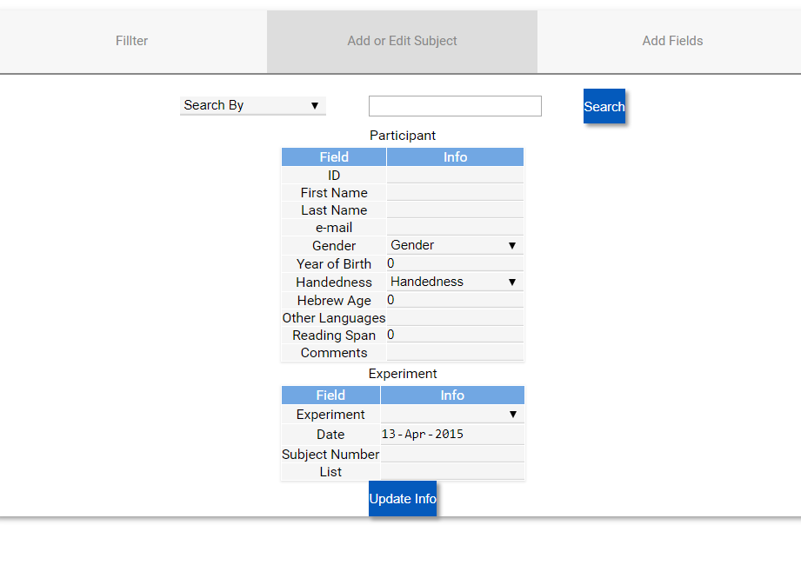
GUI Key Features

Slide 9
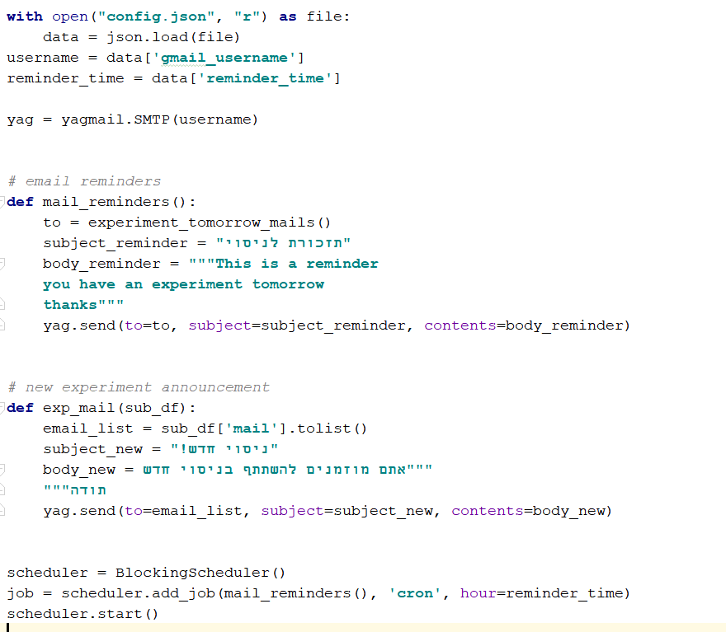
Email server

Slide 10
Main Challenges and Difficulties
Working with unfamiliar packages (+ the package we used for the GUI had very little “google support“.
Placing each GUI item in the right place.
Integrating the GUI with the DB functions.
Finding a way to have the script send reminder emails every day at the same time was difficult. This was solved with the “apscheduler” library, which allows for scheduled procedures.

Slide 11
Concluding Remarks
Is the project usable?
We have a good basis for the database and related functions
The GUI allows for simple user interaction
Email server manages to automatically send experiment reminders
What’s left to do?
Adding a way to load old data (from excel files)
Adding an option to customize emails using the GUI

